Slide 1
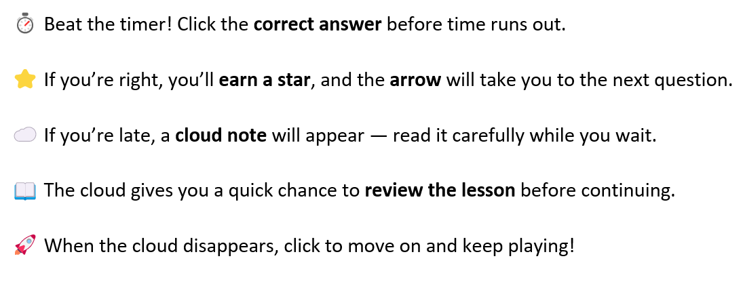
Grade 6 Science
Go

Slide 3
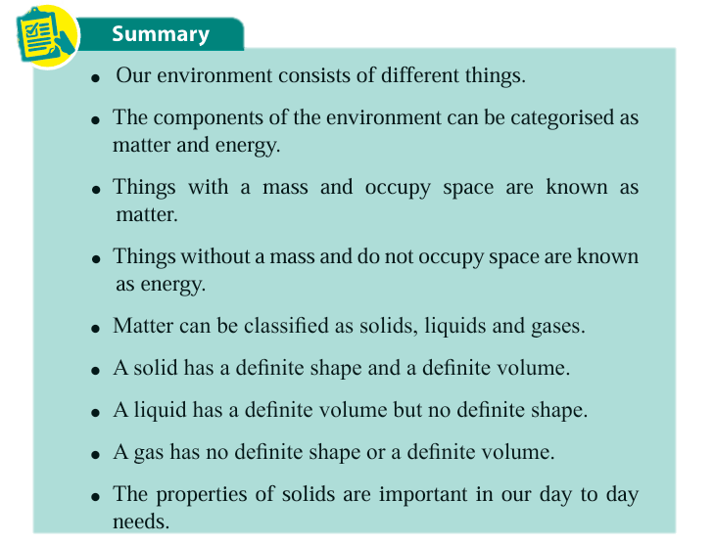

Start
Matter
Has a definite volume but no definite shape
Next
Energy
Has no definite shape or definite volume
Next
Things that have mass and occupy space
Solid
Next
Things that do not have mass and do not occupy space
Liquid
Next
Gas
Consists of matter and energy
Next
Environment
Has a definite shape and definite volume
Retry
Exit

